Slide 1
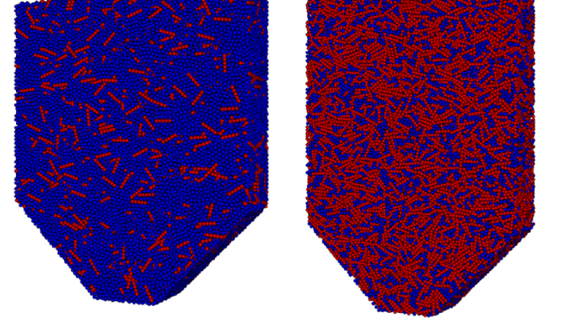
Designing a hopper flow experiment for granular chains
Ref. [11]

Slide 2
Aspects
Material
Dimensions

Slide 3
Motivation
Hoppers are used for storage but we are not trying to store our granular chains so why study hopper flow of granular chains ?

Slide 4
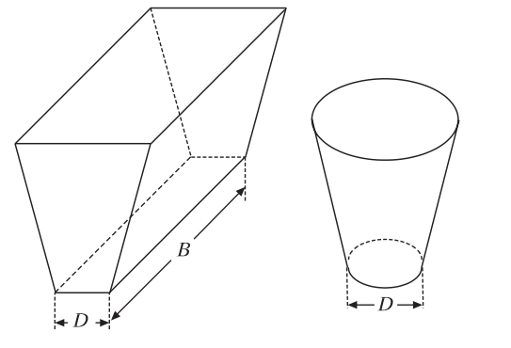
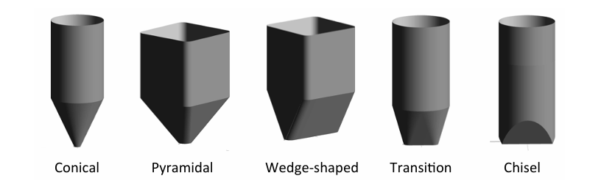
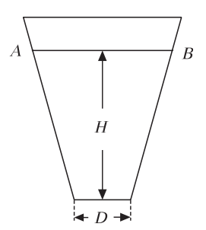
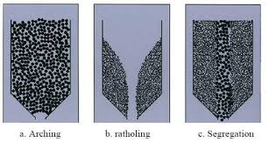
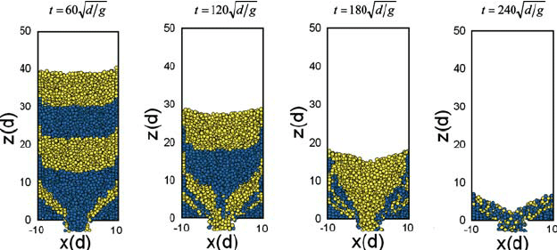
Types of hoppers
Wedge shaped hopper (plane stress field)
Conical hopper (axisymmetric stress field)
Fig. Types of 3D hoppers.[1]
Fig. Hopper Schematic. [3]
Fig. example of 2D hoppers. [2,4]
Notes:
2D hoppers let us look into the flow of granular material.

Slide 5
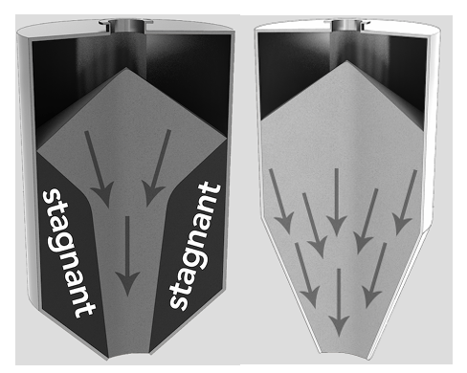
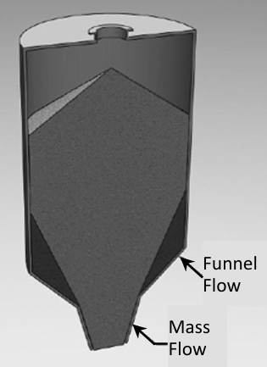
Types of steady flows
1.
2.
Funnel flow, an active flow channel forms above the outlet, with stagnant material remaining at the periphery. This occurs when the walls of the hopper section of the storage vessel are not steep enough or have low enough friction to allow flow along them.
Mass flow, the entire bed of solids is in motion when material is discharged from the outlet, including material along the walls. Mass flow bins typically have steep and/or low-friction walls. Provided that the outlet is large enough to prevent arching, all material will be discharged from the hopper, since ratholes cannot form.
Expanded flow is characterized by mass flow in the lowermost section of a bin and funnel flow in the upper section. An expanded flow bin is illustrated in Figure. The outlet of the funnel flow section must be large enough to prevent a stable rathole from developing. Because the bottom section is designed for mass flow, discharge rates are uniform and predictable. Expanded flow hoppers are frequently used when large bin diameters are required.
3.
refer [2]
Fig. Types of steady flows.
Notes:
funnel flow, an active flow channel forms above the outlet, with stagnant material remaining at the periphery. This occurs when the walls of the hopper section of the storage vessel are not steep enough or have low enough friction to allow flow along them. The size of the resultant flow channel is approximately the largest dimension of the outlet. It is equal to the diameter of a round outlet or the diagonal of a slotted outlet. In the case of conical funnel flow bins, the fraction of the vessel volume that is active can be dramatically small. If the bulk material is cohesive, a stable rathole will form thereby reducing the effective capacity of the bin to a small fraction of its intended capacity. A funnel flow bin typically exhibits a first-in last-out flow sequence. Therefore, materials that readily cake or degrade over time should not be handled in funnel flow hoppers. Funnel flow can cause erratic flow and induce high loads (depending on vessel size) on the structure and downstream equipment due to collapsing ratholes and eccentric flow channels. If the bulk solid is cohesive, ratholes may become stable, and the vessel will not empty. Funnel flow bins are best suited for bulk solids that are free flowing and do not degrade or gain strength over time. They should not be used if segregation is a concern. Funnel flow bins require less headroom and in general are less expensive to build than mass flow bins since they can have shallower walls.
In mass flow, the entire bed of solids is in motion when material is discharged from the outlet, including material along the walls. Mass flow bins typically have steep and/or low-friction walls. Provided that the outlet is large enough to prevent arching, all material will be discharged from the hopper, since ratholes cannot form. Mass flow bins are characterized by a first-in, first-out flow sequence and therefore are suitable for handling materials that degrade with time or are prone to caking. The steep hopper walls provide a 4 more uniform flow than funnel flow bins, making mass flow hoppers suitable for process vessels. Discharge rates are predictable and steady, since the bulk density of the material at the outlet is nearly independent of the head of the material inside the vessel. Segregation by the dusting or sifting mechanism is minimized, as fine and course particles separated during filling are remixed at the outlet during discharge. A disadvantage of a mass flow bin is that it requires more headroom due to its steep hopper section. This is especially the case for conical mass flow bins.
Expanded flow is characterized by mass flow in the lowermost section of a bin and funnel flow in the upper section. An expanded flow bin is illustrated in Figure 5. Funnel Flow Mass Flow Figure 5. Expanded flow pattern. The outlet of the funnel flow section must be large enough to prevent a stable rathole from developing. Because the bottom section is designed for mass flow, discharge rates are uniform and predictable. Expanded flow hoppers are frequently used when large bin diameters are required.

Slide 6
Flow problems
No flow: If a stable dome, bridge, or arch forms over the outlet of a bin, the bulk solid will not flow when the feeder is started or gate is opened. If a stable rathole forms in a vessel in which flow only occurs in a narrow channel above the outlet, material will stop flowing when the flow channel empties.
Erratic flow: Erratic flow occurs when both arching and ratholing occurs. If a rathole collapses due to external vibration, the bulk solid may arch as it impacts the outlet. After the arch fails due to vibration or operator intervention, the flow channel will empty leaving a rathole momentarily stopping flow until it eventually collapses, reforming a cohesive arch.
Flooding: If a stable rathole develops and fresh material is added or if a rathole collapses and falls into the channel, the material may become aerated or fluidized. Since most feeders are designed to handle solids and not fluids, the fluidized material may flood, that is, discharge uncontrollably in a fluidized state from the bin, and the feeder will not be able to control the rate of discharge.
Limited discharge rate: Because a fine powder dilates as it flows toward the outlet, vacuum will naturally develop inside the hopper above the outlet. As a consequence, air will flow counter to the solids, disrupting flow. Increasing the speed of the feeder will no longer increase the discharge rate of powder as the discharge rate has become limited.
Caking: Some materials will readily flow from a bin, portable container or bag if handled continuously or even after time at rest. Other materials, however, will exhibit flow problems if allowed to remain at rest for a period of time. Given enough time at rest, some bulk solids will gain additional cohesive strength, and obstructions to flow (e.g., arches and ratholes) or hard lumps may become exceptionally difficult to eliminate.
Segregation: Some materials, when transferred into a bin or pile, will segregate, that is, particles of different size, shape, density, etc. will separate. Segregation can occur by a number of different mechanisms, depending on the physical characteristics of the particles and the method of handling.
refer [2]

Slide 7
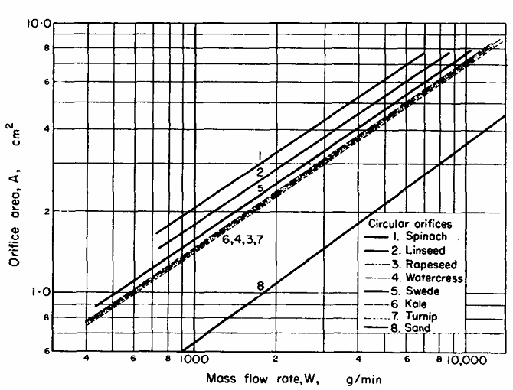
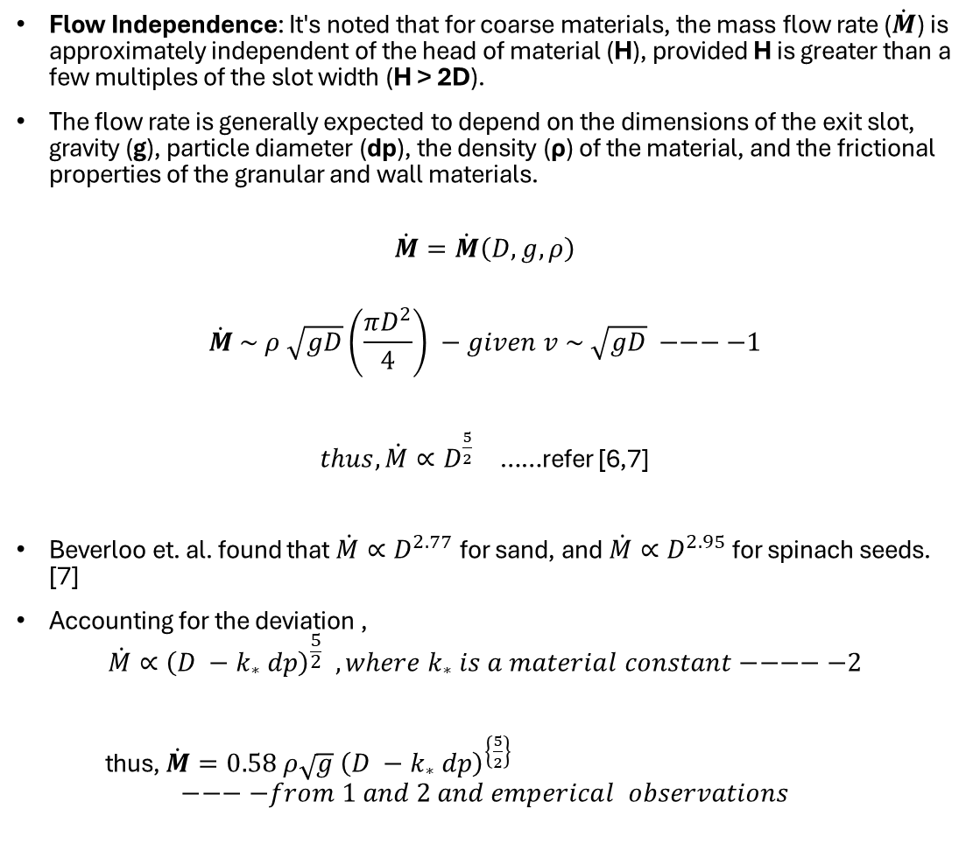
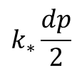
Previous studies
Flow Independence: It's noted that for coarse materials, the mass flow rate ($\dot{M}$) is approximately independent of the head of material (H), provided H is greater than a few multiples of the slot width (H > 2D).
The flow rate is generally expected to depend on the dimensions of the exit slot, gravity (g), particle diameter (dp), the density (ρ) of the material, and the frictional properties of the granular and wall materials.
$$\dot{M}=\dot{M}\left(D,g,ρ\right)$$
$$\dot{M} \sim ρ \sqrt{gD}\left(\frac{πD^{2}}{4}\right) −given v \sim \sqrt{gD} −−−−1$$
$thus, \dot{M}∝D^{\frac{5}{2}}$ ……refer [6,7]
Beverloo et. al. found that $\dot{M}∝D^{2.77}$for sand, and $\dot{M}∝D^{2.95}$for spinach seeds. [7]
Accounting for the deviation ,
$$\dot{M}∝{\left(D −k_{∗} dp\right)}^{\frac{5}{2}} , where k_{∗} is a material constant−−−−−2$$
thus, $\dot{M}=0.58 ρ\sqrt{g} {\left(D −k_{∗} dp\right)}^{\left\{\frac{5}{2}\right\}}$
$$−−−−from 1 and 2 and emperical observations$$
Fig. Influence of orifice area on flow-rate of various materials. [7]
$$k_{∗}\frac{dp}{2}$$
D
Notes:
That set the stage for further research in hopper flow idea was to consider an effective orifice diameter by excluding some outer region as shown in blue, even though no evidence for the excluded area of orifice was observed experimentally
Also Nedermann suggested that for these equations to hold the particle diameter must be between 0.4mm and D/6 and for case of D>>>k*dp velocity = 0.74 root(gD) particle exits at velocities similar to a free fall.

Slide 8
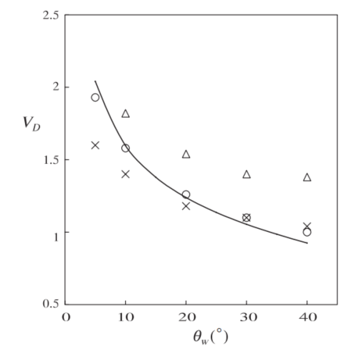
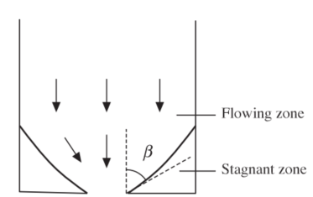
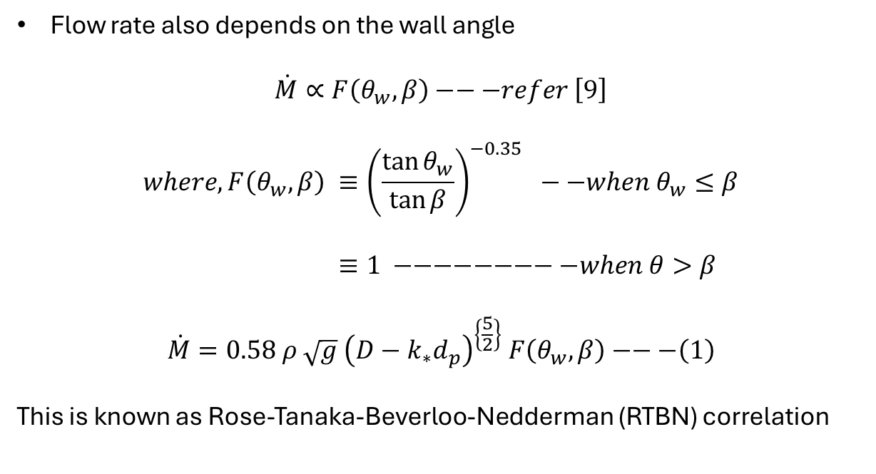
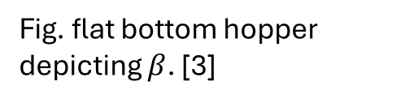
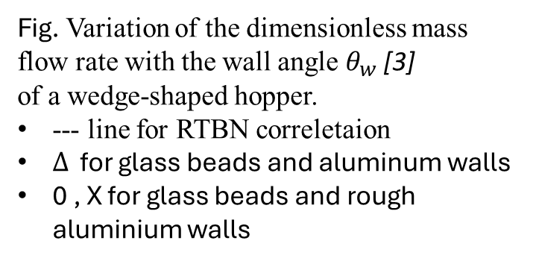
Effect of wall inclination
Flow rate also depends on the wall angle
$$\dot{M}∝F\left(θ_{w},β\right)−−−refer \left[9\right]$$
$$where, F\left(θ_{w},β\right) ≡{\left(\frac{\tan{θ_{w}}}{\tan{β}}\right)}^{−0.35} −−when θ_{w}≤β$$
$≡1 −−−−−−−−−when θ>β$
$$\dot{M}=0.58 ρ \sqrt{g} {\left(D−k_{∗}d_{p}\right)}^{\left\{\frac{5}{2}\right\}} F\left(θ_{w},β\right)−−−\left(1\right)$$
This is known as Rose-Tanaka-Beverloo-Nedderman (RTBN) correlation
Fig. Variation of the dimensionless mass flow rate with the wall angle$θ_{w}$ [3] of a wedge-shaped hopper.
--- line for RTBN correletaion
$Δ$ for glass beads and aluminum walls
0 , X for glass beads and rough aluminium walls
Fig. flat bottom hopper depicting $β$. [3]

Slide 9
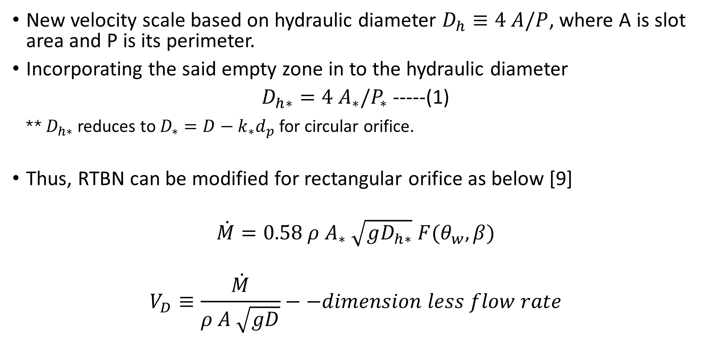
Mass flow rate for Rectangular Orifice:
New velocity scale based on hydraulic diameter $D_{h}≡4 A/P$, where A is slot area and P is its perimeter.
Incorporating the said empty zone in to the hydraulic diameter
$D_{h∗}=4 A_{∗}/P_{∗}$ -----(1)
** $D_{h∗}$reduces to $D_{∗}=D−k_{∗}d_{p}$ for circular orifice.
Thus, RTBN can be modified for rectangular orifice as below [9]
$$\dot{M}=0.58 ρ{ A}_{∗} \sqrt{gD_{h∗}} F(θ_{w},β)$$
$$V_{D}≡\frac{\dot{M}}{ρ A \sqrt{gD}}−−dimension less flow rate$$
Notes:
Where in dimensionless flow rate D is diameter for circular orifice or width for wedge-shaped hopper.

Slide 10
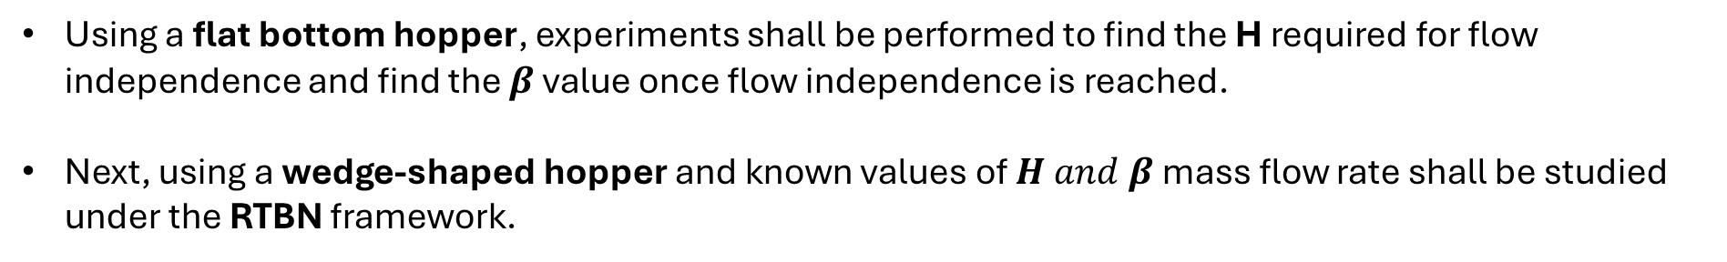
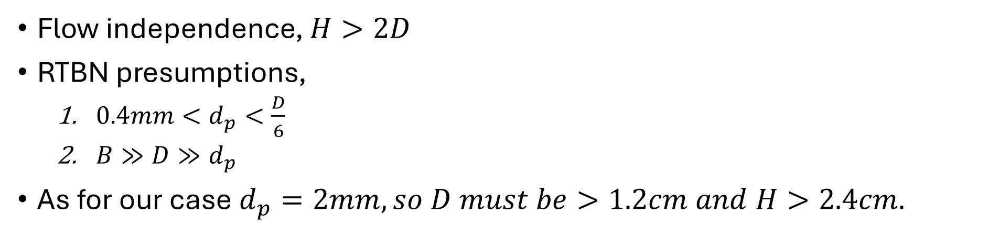
Design:
Flow independence, $H>2D$
RTBN presumptions,
$0.4mm<d_{p}<\frac{D}{6}$
$B≫D≫d_{p}$
As for our case $d_{p}=2mm, so D must be>1.2cm and H>2.4cm.$
Experiment sets:
Using a flat bottom hopper, experiments shall be performed to find the H required for flow independence and find the $β$ value once flow independence is reached.
Next, using a wedge-shaped hopper and known values of $H and β$mass flow rate shall be studied under the RTBN framework.

Slide 11
Survey of hopper flow experiment on elongated particles

Slide 12
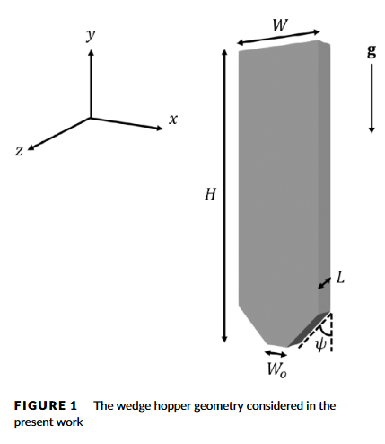
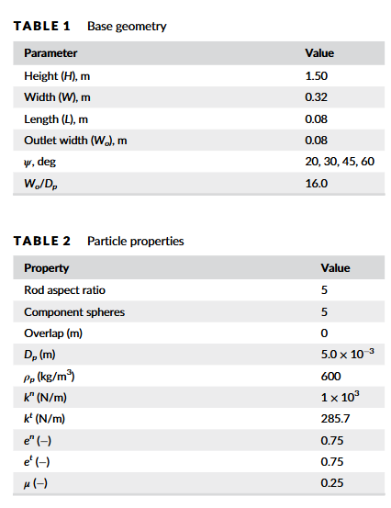
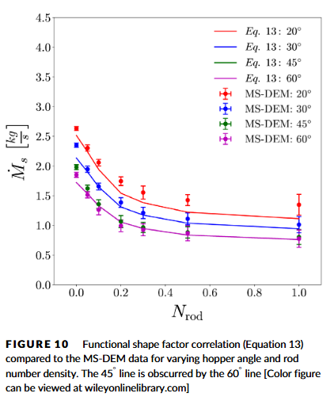
Hopper flows of mixtures of spherical and rod-like particles via the multisphere method [11] (DEM study)
Notes:
Abstract:. The multisphere discrete element method (MS-DEM) was utilized here to examine the bulk packing fraction, discharge rate, collisional stress tensor, and order parameter of a bi-disperse sphere-rod mixture evacuating a hopper. A modified form of the Myers and Sellers correlation with variable shape factor is capable of replicating the MS-DEM discharge data. The collisional stress tensor is observed to be highly symmetric for mono-disperse spheres but becomes asymmetric when rod-like particles are introduced. The order parameter within the hopper increases significantly during discharge and the rod-like particles undergo shear induced alignment with their long dimensions orthogonal to the outflow plane.

Slide 13
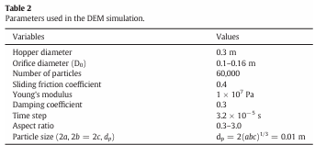
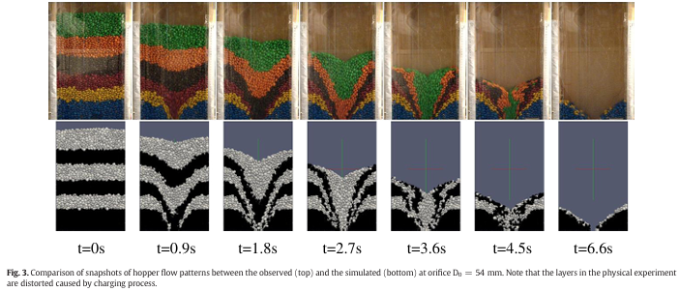
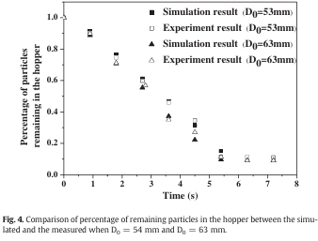
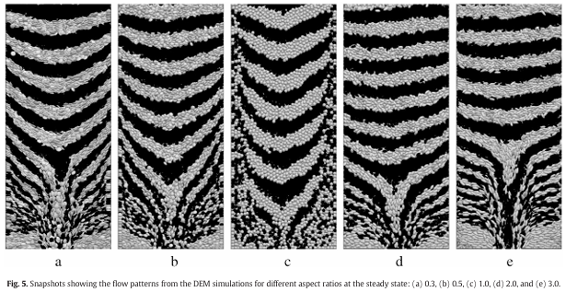
Flow characteristics and discharge rate of ellipsoidal particles in a flat bottom hopper [13] (expt. and DEM study)
Notes:
Abstract: Hopper flow characteristics are significantly affected by particle shape. In this work, ellipsoidal particles which can represent a large number of shapes are used to investigate the shape effect on granular flow in a cylindrical hopper.Numericalexperimentsareconductedbyuseofthediscreteelementmethod,withitsvalidityverifiedby comparison with the results from physical experiments. The results indicate that particle shape can make a sig nificant effect on the flow pattern. In particular, the increase of deviation from spheres can decrease the mixed region adjacent to the side wall, and increase the stagnant zone at the bottom corner. It may also lead to decreased wall stress. Furthermore, particle shape has a significant effect on the discharge rate. Spheres of unity aspect ratio have the highest flow rate, and the lower or higher aspect ratio, the smaller the flow rate. Based on the numerical results, the Beverloo equation is modified, where parameters C and k in the equation are respectively formulated as a function of aspect ratio.

Slide 14
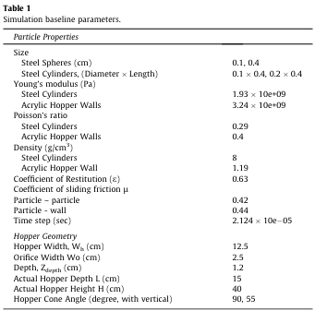
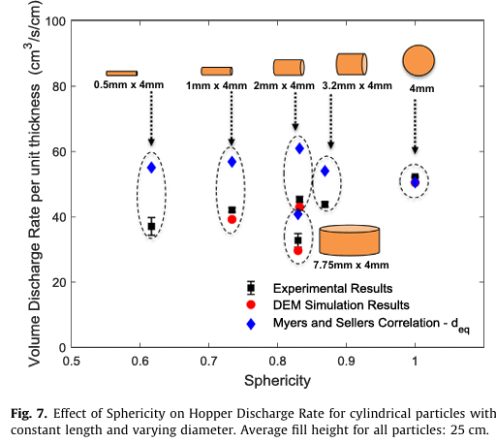
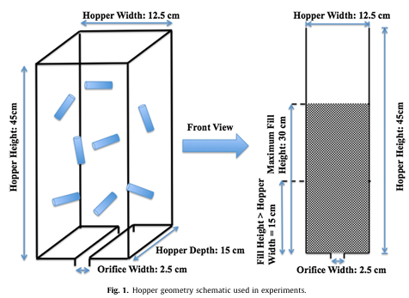
Hopper discharge of elongated particles of varying aspect ratio: Experiments and DEM simulations [14] (Expt and DEM study)
 | cm
Orifice width | 2.5cm
Hopper depth | 15 cm
Hopper width | 12.5cm
Hopper height | 45 cm
Filll height | 30cm
Particle shape | L (mm) | D (mm)
Cylindrical | 1 | 8
Cylindrical | 1 | 4
Cylindrical | 1 | 2
Cylindrical | 2 | 4
Cylindrical | 7.75 | 4
Cylindrical | 4 | 4
Notes:
Abstract: Steady flow of particulate or granular materials and bulk solids through a hopper plays a critical role in manyindustrial and process engineering applications. The present work investigates hopper discharge of non-spherical particles, specifically cylindrical particles, from a rectangular hopper. The behavior of steel cylindrical particles with varying aspect ratio (both varying diameter with constant length and varying length with constant diameter) was explored experimentally and via DEM simulations. In addition, the effects of fill height, particle friction, hopper orifice width and hopper cone angle on hopper discharge rate of non-spherical particles were studied via DEM simulations and compared with previously pub lished experimental correlations, experimental results of spherical particles. The results indicate that DEMsimulations are fully capable of reproducing trends that are established experimentally. The results with particles of high aspect ratio indicate a different trend than that previously observed with rounded particles. As the fill height increases, the mass discharge rate increases and then asymptotes; further increases in fill height cause a decrease in the mass discharge rate. Further, the effect of particle friction showed a significant influence on the hopper discharge behavior. In addition, a decrease in the hopper angle from 90 degree to critical angle 55 degree decreases the mass discharge rate flow and further decrease in hopper angle increases the discharge rate rapidly.

Slide 15
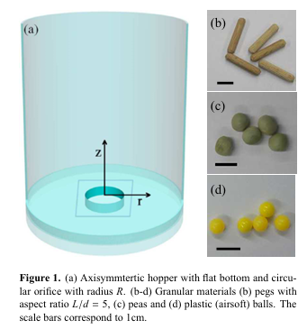
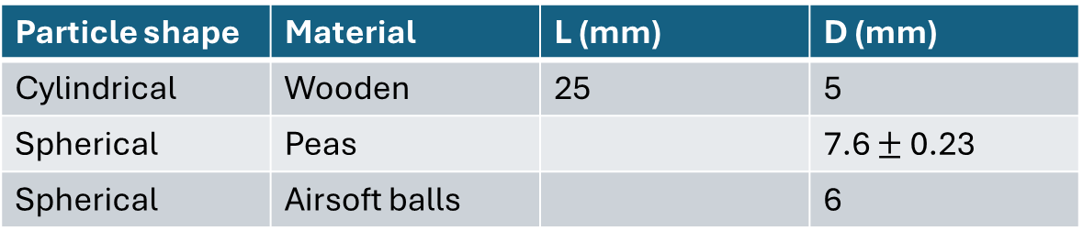
Elongated grains in a hopper [15] (Expt. study)
Particle shape | Material | L (mm) | D (mm)
Cylindrical | Wooden | 25 | 5
Spherical | Peas |  | 7.6 $±$ 0.23
Spherical | Airsoft balls |  | 6
 | H | D
Hopper | 21.4 cm | 19 cm
Orifice |  | 35mm (variable)
Notes:
Abstract: Flow and clogging of granular materials in a 3-dimensional hopper is investigated experimentally. Weuse X-ray tomography and optical methods to study this phenomenon for spherical and elongated particles. The X-ray tomograms provide information on the bulk of the hopper filling, and allow to determine the particle positions and orientations inside the silo, as well as spatial variations of the local packing density. We find that particles show a preferred orientation and thereby an enhanced order in the flowing zone of the silo. Similarly to simple shear flows, the average orientation of the particles is not parallel to the streamlines but encloses a certain angle with them. The clogged state is characterized by a dome, i. e. the geometry of the layer of grains blocking the outflow. The number of grains forming this blocking layer is larger for elongated grains compared to the case of spheres of the same volume.

Slide 16
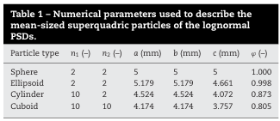
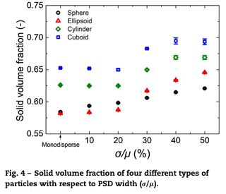
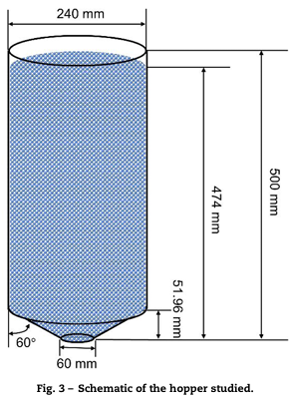
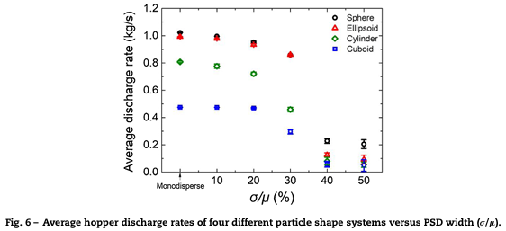
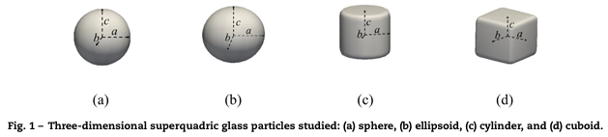
Effect of lognormal particle size distributions of non-spherical particles on hopper discharge characteristics – Ya Zhao, Jia Wei Chew [12] (DEM study)
Notes:
Abstract: This study focusses on the hopper discharge characteristics of lognormal particle size distri butions (PSDs) of non-spherical particles (namely, ellipsoids, cylinders and cuboids). Discrete element method is employed to understand the coupled effects of sphericity and lognor mal PSD width. The results reveal that: (i) the ellipsoids have the most similar discharge behaviors with the spheres, but the differences increase as the PSD width increases; (ii) the packing density in the hopper increases as PSD width increases and particle spheric ity decreases; (iii) regardless of sphericity, the discharge rate decreases and the jamming probability increases as the PSD width increases; (iv) for the same PSD width, the jamming probability is the greatest for cuboids and least for the ellipsoids; and (v) the lower-sphericity cylinder and cuboid have some residual particles left in the hopper upon complete discharge, and the number of residues is greater and increases with PSD width for the latter. The results provide new insights regarding the behavior of wide PSDs of non-spherical particles in the hopper, highlighting the non-negligible impact of the coupled effect of PSD and particle non-sphericity.

Slide 17
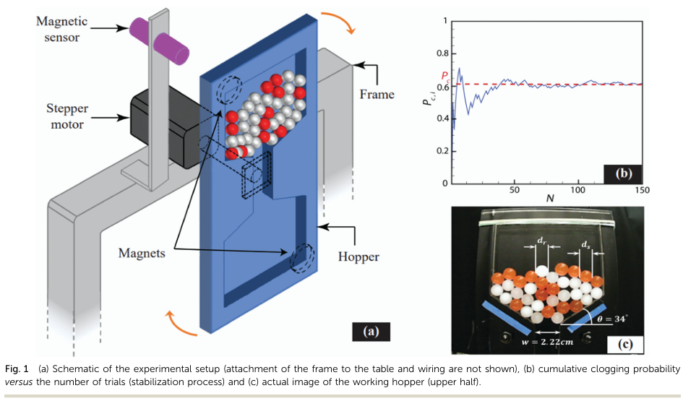
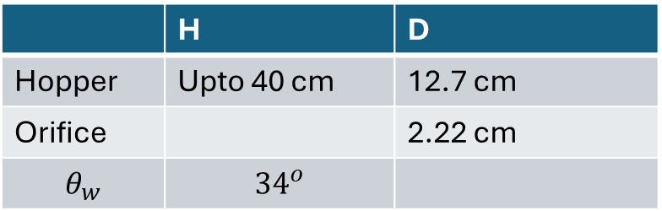
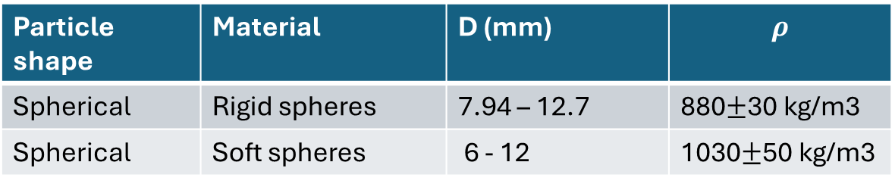
Soft particles facilitate flow of rigid particles in a 2D hopper [16] (Expt.and DEM study)
 | H | D
Hopper | Upto 40 cm | 12.7 cm
Orifice |  | 2.22 cm
$$θ_{w}$$ | $${34}^{o}$$
Particle shape | Material | D (mm) | $$ρ$$
Spherical | Rigid spheres | 7.94 – 12.7 | 880$±$30 kg/m3
Spherical | Soft spheres | 6 - 12 | 1030$±$50 kg/m3
Notes:
Abstract: We study clogging through a 2D hopper in systems consisting of a combination of soft and rigid particles of different sizes and mixing fractions. soft particles play a lubricating role in the flow of rigid spheres due to their deformability and slick surface, but the size of rigid particles influences clogging more than the size of soft ones. Without any adjustable parameters, the simulation results capture the clogging probability of soft-rigid particle mixtures through a 2D hopper.

Slide 18
What does it mean for chains

Slide 19
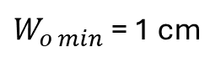
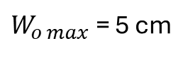
Initial Design:
1.5 cm
W = 30 cm
L = 2.3 mm
FOV : 10cm X 10 cm
H = 60 cm
Field of view
$W_{o min}$ = 1 cm
m5 screws
1 cm
$W_{o max}$ = 5 cm
Notes:
Angle can vary in continuous manner as the angled wall can be screwed on the curved groove at any desired location.

Slide 20
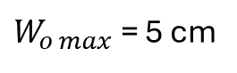
Initial Design:
1.5 cm
W = 30 cm
The groove would be on front and back plates
L = 2.3 mm
FOV : 10cm X 10 cm. *can be increased if resolution allows as PTV is to be performed.
30 cm
m5 screws
H = 60 cm
Field of view
$W_{o min}$ = 1 cm
h
m3 screws
1 cm
0.5 cm
$W_{o max}$ = 5 cm
Notes:
Angle can vary in continuous manner as the angled wall can be screwed on the curved groove at any desired location.

Slide 21
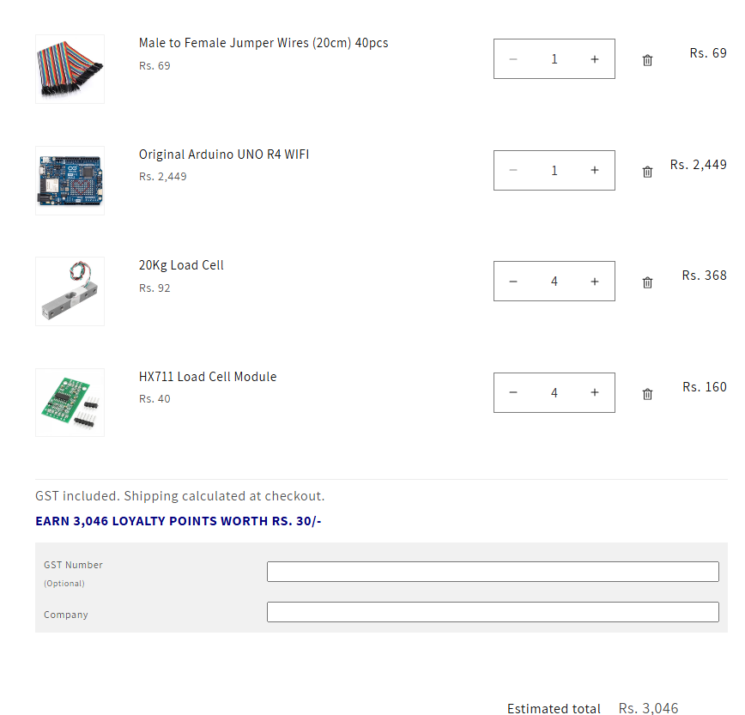
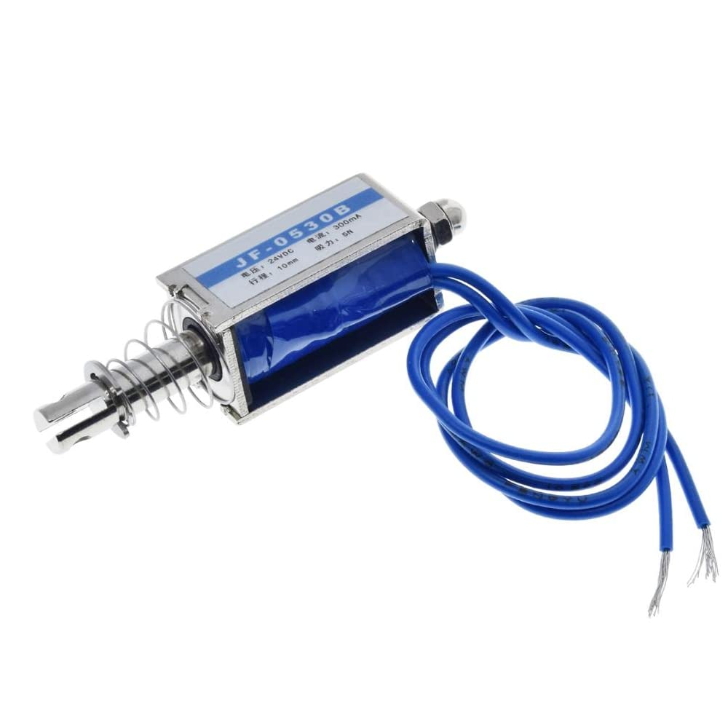
Actuator and Weight DAQ system
Solenoid actuator

Slide 22
Expense Estimate:
Name | Units | price | total
Actuator # | 2 | 402 | 804
20Kg load cell # | 4 | 92 | 368
HX711 controller # | 4 | 40 | 160
Arduino UNO R4 # | 1 (optional) | 2449 | 2449
Display module | 1 (optional) | 1218 | 1218
Jumper wires # | 1 set | 69 | 69
Acrylic sheets | 2 | 3470 + gst | 8190
Slotted Angles # | 2 (72 inch) |  | 1149
Slotted Angles # | 8 (36 inch) |  | 2,179
Hopper parts |  | 5000 | 5000 +
 |  |  | 21218 +

Slide 23
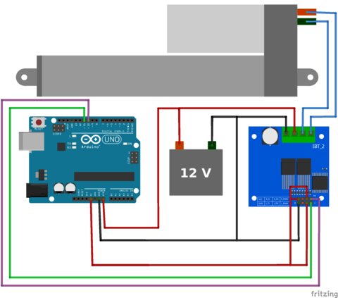
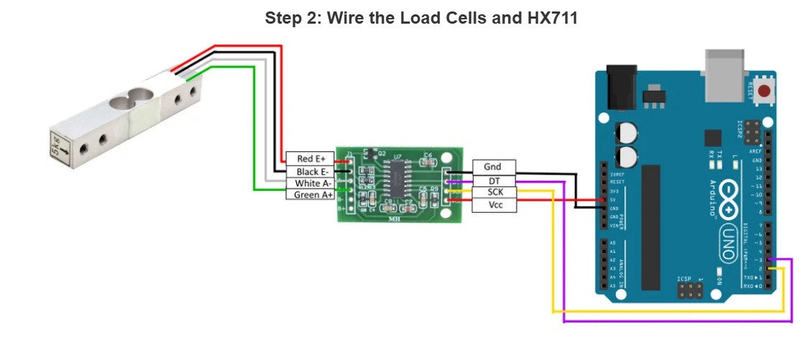
Circuit Diagrams:
HX711 with a Four Wire Load Cell and Arduino | Step by Step Guide. (youtube.com)
Arduino Scale With 5kg Load Cell and HX711 Amplifier : 4 Steps (with Pictures) - Instructables
How To Control a Linear Actuator with an Arduino? | FIRGELLI (firgelliauto.com)

Slide 24
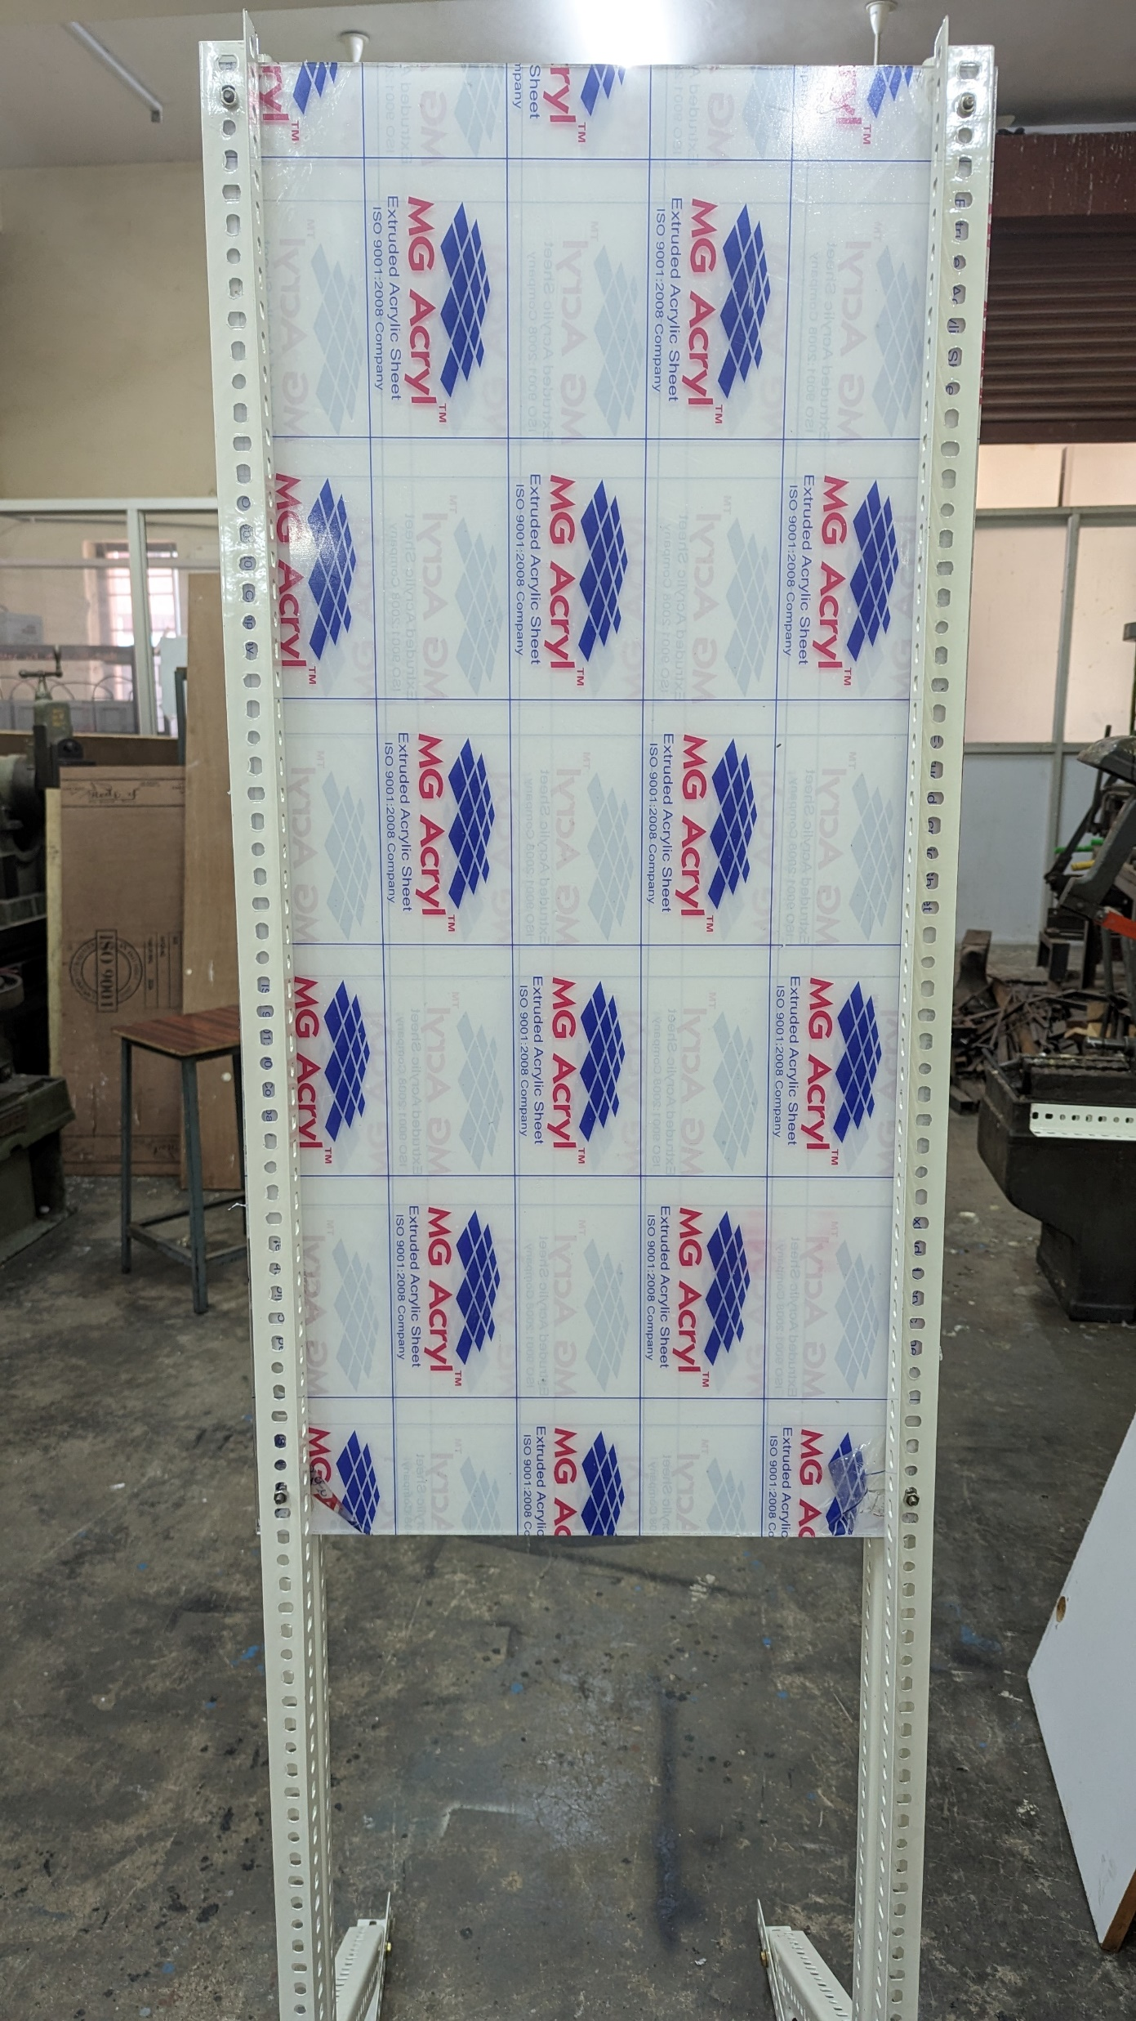
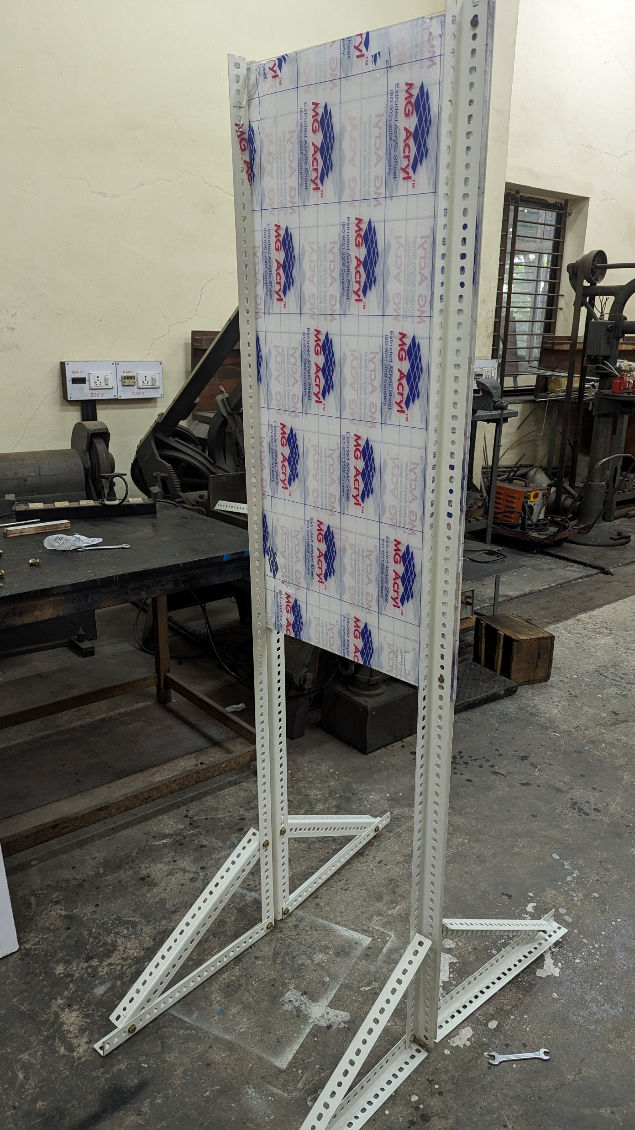
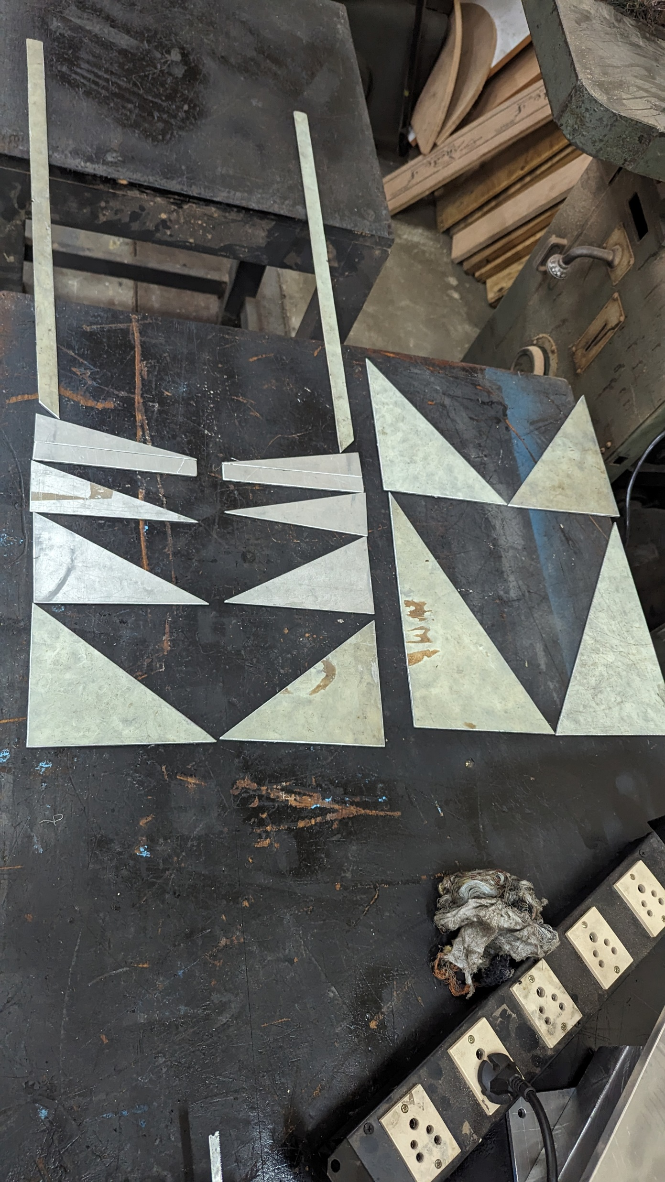
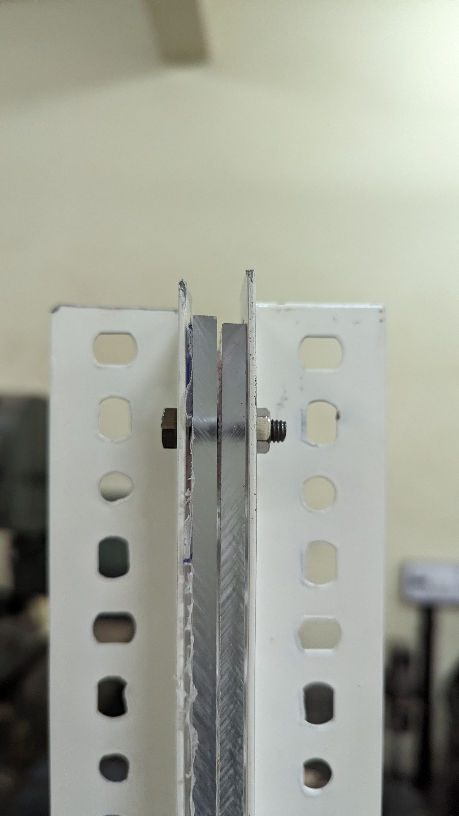
Setup build progress:
Plates

Slide 25



Scale build progress:
Top View :
Front View :
Power port
Programming Port
Top Plate
Side View :
Top Plate
Load Cell
Display

Slide 26

App build progress:

Slide 27

References:
Perry’s Chemical Engineers’ Handbook, 9th Edition Powder Flow and Hopper Design.
Scaled Physical Modeling of the Dynamics of Granular Flow in Scaled Physical Modeling of the Dynamics of Granular Flow in Hopper Silos Hagos Eman, The University of Western Ontario.
K. Kesava Rao, Prabhu R. Nott - An Introduction to Granular Flow-Cambridge University Press (2008).
Effect of lognormal particle size distributions of non-spherical particles on hopper discharge characteristics (https://doi.org/10.1016/j.cherd.2020.09.001).
Huber-Burnand, 1829, cited in Herbst and Winterkorn, 1965, p. 3; (https://doi.org/10.1002/andp.18290920611)
Hagen, 1852, cited in Wieghardt, 1975 (https://doi.org/10.1007/s10035-006-0027-x);
The flow of granular solids through orifices ,Beverloo et al., 1961 (https://doi.org/10.1016/0009-2509(61)85030-6);
Al-Din and Gunn, 1984 (https://doi.org/10.1016/0009-2509(84)80137-2);
Nedderman, 1992 (https://doi.org/10.1017/CBO9780511600043), p. 293
Rate of discharge of granular materials from bins and hoppers, January 1959 208:465-469, Rose and Tanaka (1959).
Hopper flows of mixtures of spherical and rod-like particles viathe multisphere method.-- Aaron M. Lattanzi| Jonathan J. Stickel.
Effect of lognormal particle size distributions of non-spherical particles on hopper discharge characteristics – Ya Zhao, Jia Wei Chew.
Flow characteristics and discharge rate of ellipsoidal particles in a flat bottom hopper - S.D. Liu, Z.Y. Zhou, R.P. Zou, D. Pinson, A.B. Yu.
Hopper discharge of elongated particles of varying aspect ratio: Experiments and DEM simulations - Henna Tangri, Yu Guo, Jennifer S. Curtis.
Elongated grains in a hopper - Tamás Börzsönyi, Ellák Somfai, Balázs Szabó, , Sandra Wegner, Ahmed Ashour, and Ral Stannarius2,†
Soft particles facilitate flow of rigid particles in a 2D hopper - Saeed Alborzi, aBenjamin G. Clarka and Sara M. Hashmi

Slide 28
Vocabulary
Chute – equipment used to transfer bulk material by gravity between other pieces of equipment. The cross-section must be only partially full of material; otherwise it acts as a sloping bin or hopper.
Cylinder – vertical part of a bin. The cylinder may be round or rectangular and has a constant cross section.
Expanded flow – flow pattern inside a bin, where all the bulk material is in motion in the bottom portion of the vessel when withdrawn, but flow only occurs in a flow channel in the top portion of the vessel centered over the outlet.
Feeder – device for modulating the withdrawal rate of bulk material, e.g., rotary valves, screw feeders, and belt feeders. Often, a valve or gate is used to stop and start flow, but such devices in general should not be used to control the discharge rate of bulk solids.
Flow channel – the space in a bin in which the bulk solid is actually flowing at any point in time during withdrawal.
Funnel flow – flow pattern inside a bin, where the bulk material only moves in a flow channel above the outlet when withdrawn.
Hopper section – the converging part of a storage vessel that has sloped walls and a variable cross section.
Mass flow – flow pattern inside a bin where all material is in motion when withdrawn.
Process vessel – a bin that has been modified to allow heating, cooling, drying, reacting, or other processes to take place. Frequently they are equipped with heat exchangers or distributors for gas injection.

